Slide 1
Data Mining: Data
Lecture 2
Data Mining

Slide 2
Outline
Attributes and Objects
Types of Data
Data Quality
Similarity and Distance
Data Preprocessing

Slide 3
What is Data?
Collection of data objects and their attributes
An attribute is a property or characteristic of an object
Examples: eye color of a person, temperature, etc.
Attribute is also known as variable, field, characteristic, dimension, or feature
A collection of attributes describe an object
Object is also known as record, point, case, sample, entity, or instance
Attributes
Objects

Slide 4
Attribute Values
Attribute values are numbers or symbols assigned to an attribute for a particular object
Distinction between attributes and attribute values
Same attribute can be mapped to different attribute values
Example: height can be measured in feet or meters
Different attributes can be mapped to the same set of values
Example: Attribute values for ID and age are integers

Slide 5
Types of Attributes
There are different types of attributes
Nominal
Examples: ID numbers, eye color, zip codes
Ordinal
Examples: rankings (e.g., taste of potato chips on a scale from 1-10), grades, height {tall, medium, short}
Interval
Examples: calendar dates, temperatures in Celsius or Fahrenheit.
Ratio
Examples: temperature in Kelvin, length, counts, elapsed time (e.g., time to run a race)

Slide 6
Discrete and Continuous Attributes
Discrete Attribute
Has only a finite or countably infinite set of values
Examples: zip codes, counts, or the set of words in a collection of documents
Often represented as integer variables.
Continuous Attribute
Has real numbers as attribute values
Examples: temperature, height, or weight.
Practically, real values can only be measured and represented using a finite number of digits.

Slide 7
Asymmetric Attributes
Only presence (a non-zero attribute value) is regarded as important
Words present in documents
Items present in customer transactions

Slide 8
Important Characteristics of Data
Dimensionality (number of attributes)
High dimensional data brings a number of challenges
Sparsity
Only presence counts
Resolution
Patterns depend on the scale
Size
Type of analysis may depend on size of data

Slide 9
Types of data sets
Record
Data Matrix
Document Data
Transaction Data
Graph
World Wide Web
Molecular Structures
Ordered
Spatial Data
Temporal Data
Sequential Data
Genetic Sequence Data

Slide 10
Record Data
Data that consists of a collection of records, each of which consists of a fixed set of attributes

Slide 11
Data Matrix
If data objects have the same fixed set of numeric attributes, then the data objects can be thought of as points in a multi-dimensional space, where each dimension represents a distinct attribute
Such a data set can be represented by an m by n matrix, where there are m rows, one for each object, and n columns, one for each attribute

Slide 12
Document Data
Each document becomes a ‘term’ vector
Each term is a component (attribute) of the vector
The value of each component is the number of times the corresponding term occurs in the document.

Slide 13
Transaction Data
A special type of data, where
Each transaction involves a set of items.
For example, consider a grocery store. The set of products purchased by a customer during one shopping trip constitute a transaction, while the individual products that were purchased are the items.
Can represent transaction data as record data

Slide 14
Graph Data
Examples: Generic graph, a molecule, and webpages
Benzene Molecule: C6H6

Slide 15
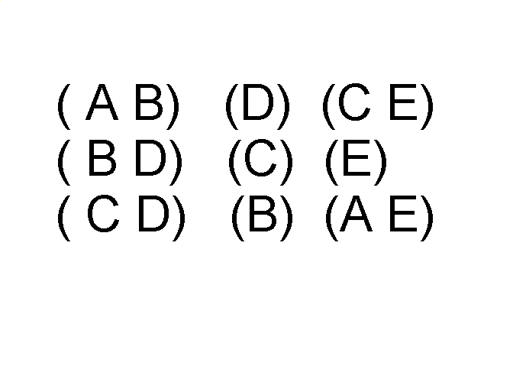
Ordered Data
Sequences of transactions
Items/Events
An element of the sequence

Slide 16
Ordered Data
Genomic sequence data

Slide 17
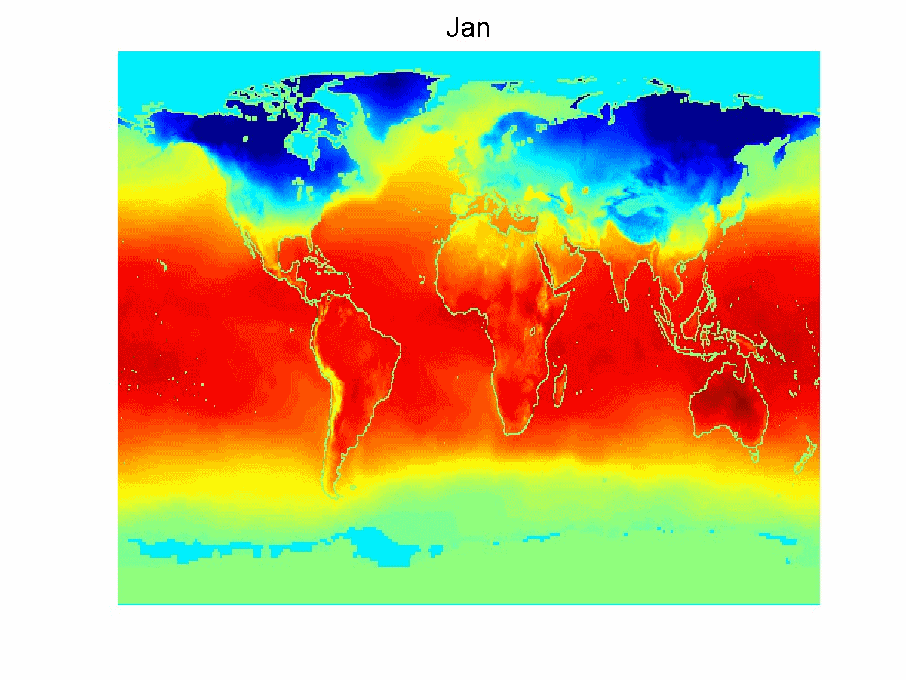
Ordered Data
Spatio-Temporal Data
Average Monthly Temperature of land and ocean

Slide 18
Data Quality
Poor data quality negatively affects many data processing efforts
Data mining example: a classification model for detecting people who are loan risks is built using poor data
Some credit-worthy candidates are denied loans
More loans are given to individuals that default

Slide 19
Data Quality …
What kinds of data quality problems?
How can we detect problems with the data?
What can we do about these problems?
Examples of data quality problems:
Noise and outliers
Wrong data
Fake data
Missing values
Duplicate data

Slide 20
Noise
For objects, noise is an extraneous/irrelevant object
For attributes, noise refers to modification of original values
Examples: distortion of a person’s voice when talking on a poor phone
The figures below show two sine waves of the same magnitude and different frequencies, the waves combined, and the two sine waves with random noise
The magnitude and shape of the original signal is distorted

Slide 21

Outliers
Outliers are data objects with characteristics that are considerably different than most of the other data objects in the data set
Case 1: Outliers are noise that interferes with data analysis
Case 2: Outliers are the goal of our analysis
Credit card fraud
Intrusion detection

Slide 22
Missing Values
Reasons for missing values
Information is not collected (e.g., people decline to give their age and weight)
Attributes may not be applicable to all cases (e.g., annual income is not applicable to children)
Handling missing values
Eliminate data objects or variables
Estimate missing values
Example: time series of temperature
Example: census results
Ignore the missing value during analysis

Slide 23
Duplicate Data
Data set may include data objects that are duplicates, or almost duplicates of one another
Major issue when merging data from heterogeneous sources
Examples:
Same person with multiple email addresses
Data cleaning
Process of dealing with duplicate data issues

Slide 24
Similarity and Dissimilarity Measures
Similarity measure
Numerical measure of how alike two data objects are.
Is higher when objects are more alike.
Often falls in the range [0,1]
Dissimilarity measure
Numerical measure of how different two data objects are
Lower when objects are more alike
Minimum dissimilarity is often 0
Upper limit varies
Proximity refers to a similarity or dissimilarity

Slide 25
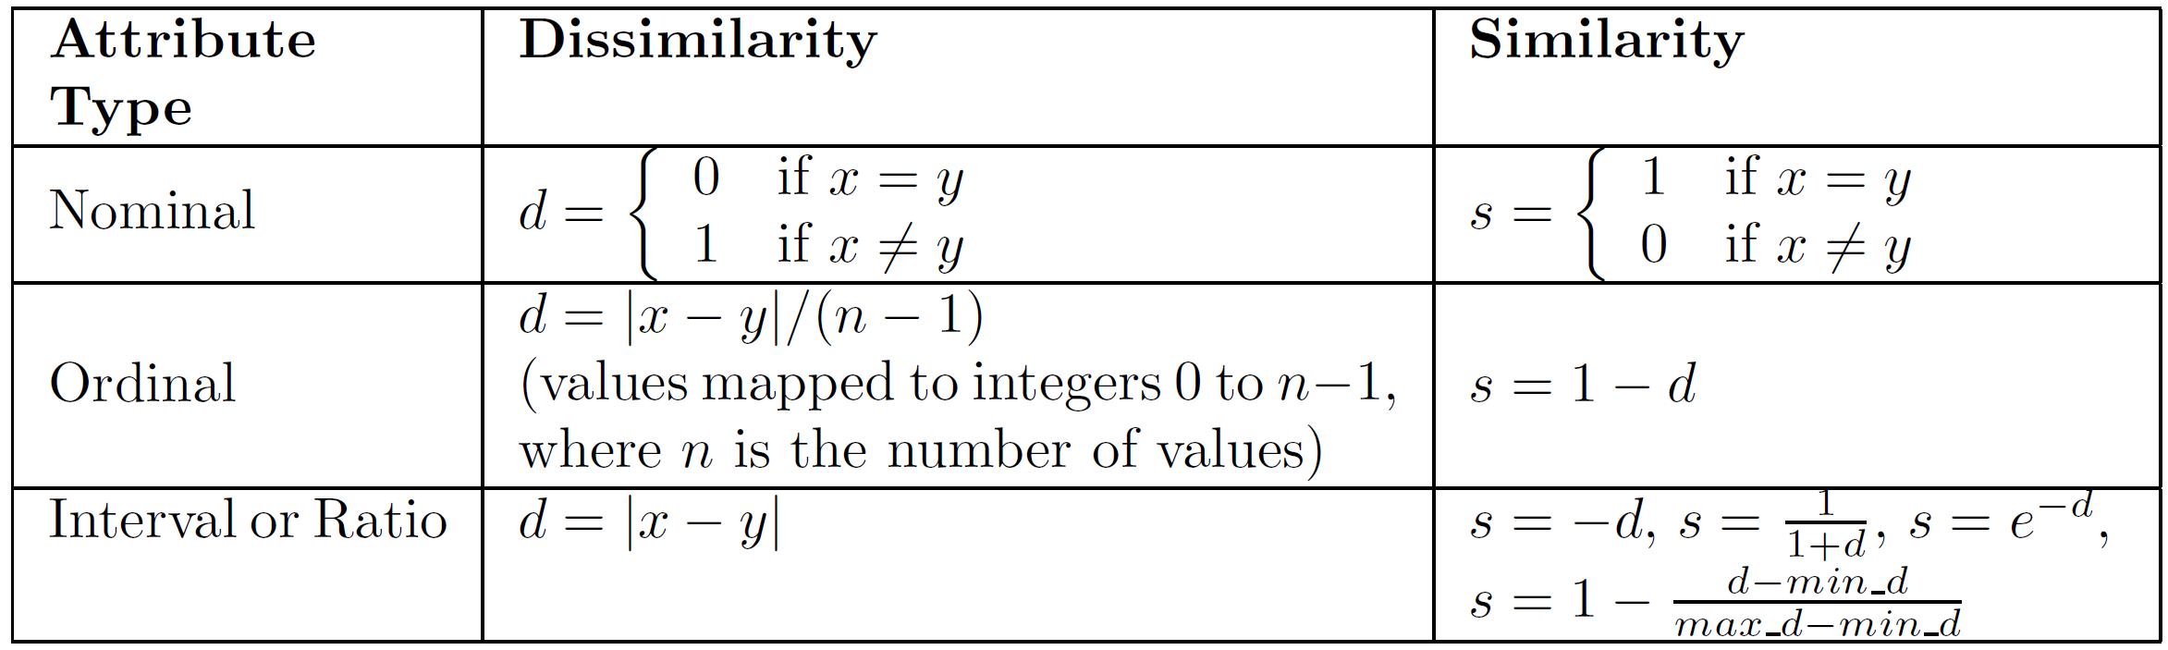
Similarity/Dissimilarity for Simple Attributes
The following table shows the similarity and dissimilarity between two objects, x and y, with respect to a single, simple attribute.

Slide 26
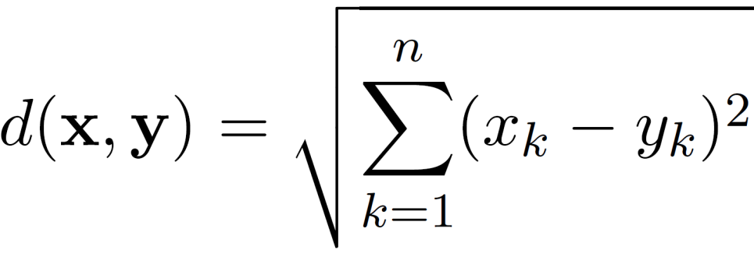
Euclidean Distance
Euclidean Distance
where n is the number of dimensions (attributes) and x_{k} and y_{k} are, respectively, the k^{th} attributes (components) or data objects x and y.
Standardization is necessary, if scales differ.

Slide 27
Euclidean Distance
Distance Matrix

Slide 28
Distance Matrix

Slide 29
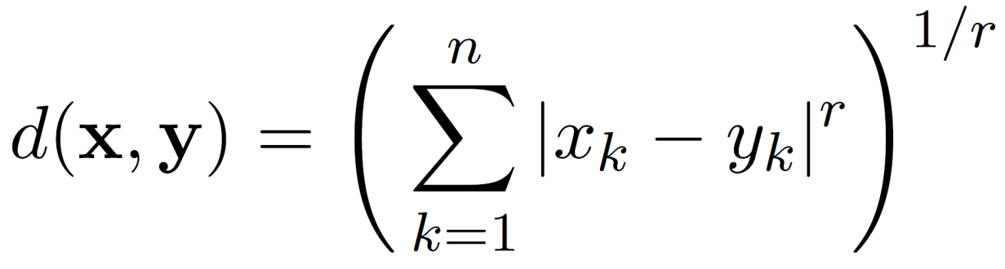
Minkowski Distance
Minkowski Distance is a generalization of Euclidean Distance
Where r is a parameter, n is the number of dimensions (attributes) and x_{k} and y_{k} are, respectively, the k^{th} attributes (components) or data objects x and y.

Slide 30
Minkowski Distance: Examples
r = 1. City block (Manhattan, taxicab, L₁ norm) distance.
A common example of this for binary vectors is the Hamming distance, which is just the number of bits that are different between two binary vectors
r = 2. Euclidean distance
r → ∞. “supremum” (L_{max} norm, L∞ norm) distance.
This is the maximum difference between any component of the vectors
Do not confuse r with n, i.e., all these distances are defined for all numbers of dimensions.

Slide 31
Minkowski Distance
Distance Matrix

Slide 32
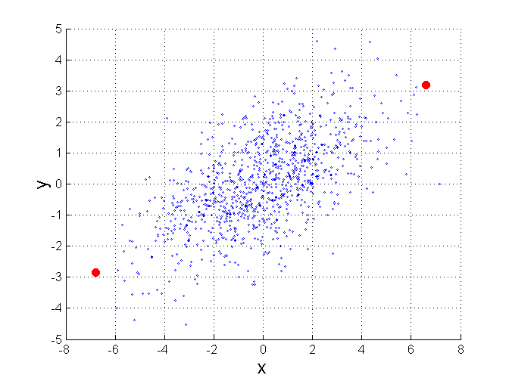
Mahalanobis Distance
$mahalanobis\left(x,y\right)={ ((x−y)}^{T}Ʃ^{−1}(x−y))$^{-0.5}
Σ is the covariance matrix
For red points, the Euclidean distance is 14.7, Mahalanobis distance is 6.

Slide 33
Data Preprocessing
Aggregation
Sampling
Discretization and Binarization
Attribute Transformation
Dimensionality Reduction
Feature subset selection
Feature creation

Slide 34
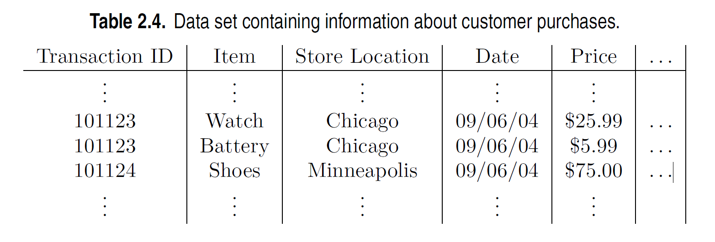
Aggregation
Combining two or more attributes (or objects) into a single attribute (or object)
Purpose
Data reduction - reduce the number of attributes or objects
Change of scale
Cities aggregated into regions, states, countries, etc.
Days aggregated into weeks, months, or years
More “stable” data - aggregated data tends to have less variability

Slide 35
Example: Precipitation in Australia
This example is based on precipitation in Australia from the period 1982 to 1993.
The next slide shows
A histogram for the standard deviation of average monthly precipitation for 3,030 0.5◦ by 0.5◦ grid cells in Australia, and
A histogram for the standard deviation of the average yearly precipitation for the same locations.
The average yearly precipitation has less variability than the average monthly precipitation.
All precipitation measurements (and their standard deviations) are in centimeters.

Slide 36
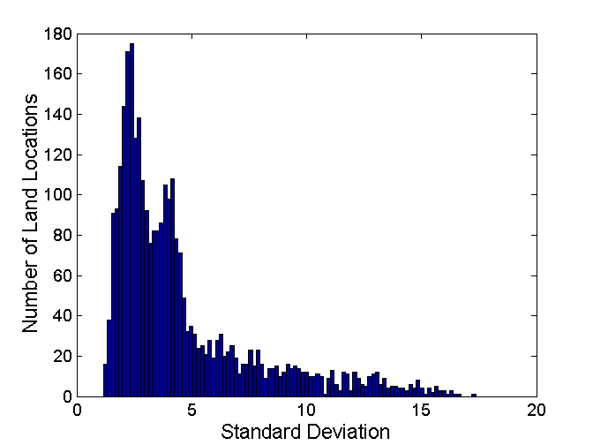
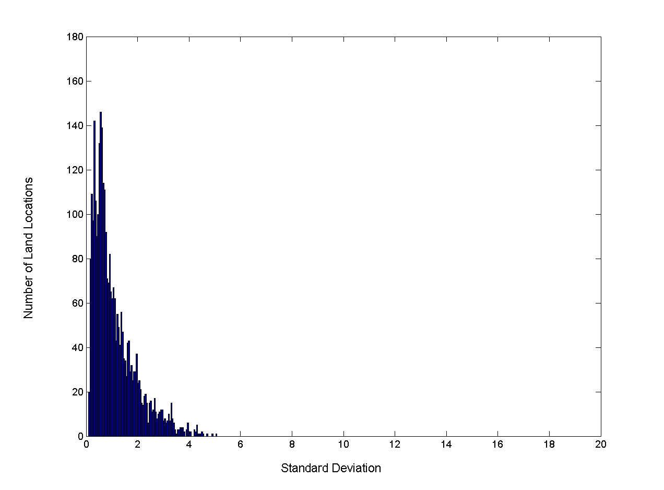
Example: Precipitation in Australia …
Variation of Precipitation in Australia
Standard Deviation of Average Monthly Precipitation
Standard Deviation of Average Yearly Precipitation

Slide 37
Sampling
Sampling is the main technique employed for data reduction.
It is often used for both the preliminary investigation of the data and the final data analysis.
Statisticians often sample because obtaining the entire set of data of interest is too expensive or time consuming.
Sampling is typically used in data mining because processing the entire set of data of interest is too expensive or time consuming.

Slide 38
Sampling …
The key principle for effective sampling is the following:
Using a sample will work almost as well as using the entire data set, if the sample is representative
A sample is representative if it has approximately the same properties (of interest) as the original set of data

Slide 39

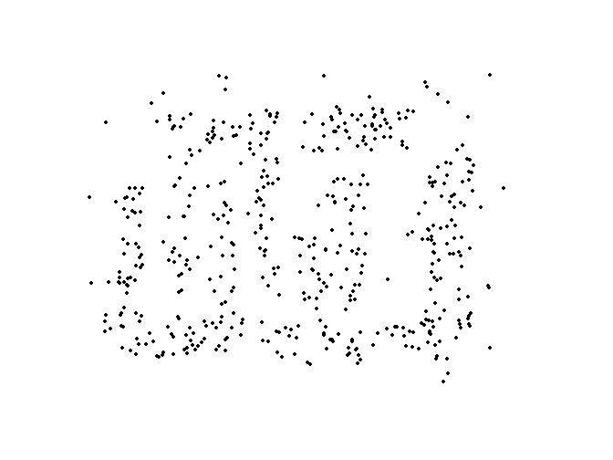
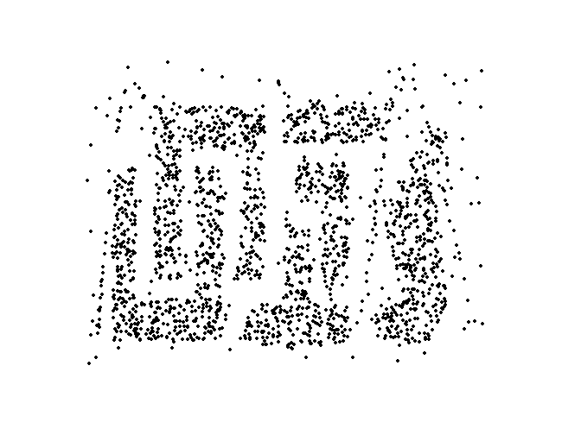
Sample Size
8000 points 2000 Points 500 Points

Slide 40
Types of Sampling
Simple Random Sampling
There is an equal probability of selecting any particular item
Sampling without replacement
As each item is selected, it is removed from the population
Sampling with replacement
Objects are not removed from the population as they are selected for the sample.
In sampling with replacement, the same object can be picked up more than once
Stratified sampling
Split the data into several partitions; then draw random samples from each partition

Slide 41
Discretization
Discretization is the process of converting a continuous attribute into an ordinal attribute
A potentially infinite number of values are mapped into a small number of categories
Discretization is used in both unsupervised and supervised settings

Slide 42
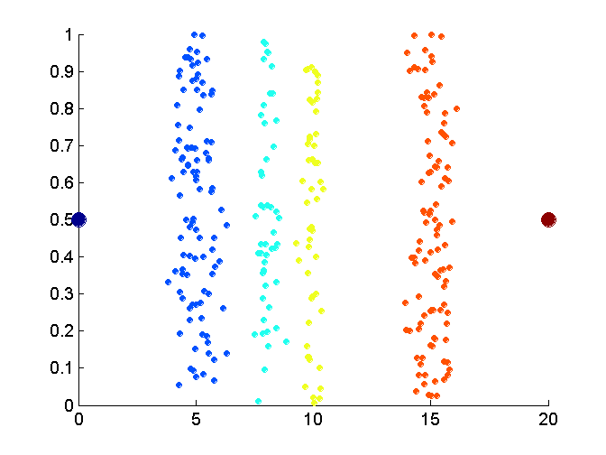
Unsupervised Discretization
Data consists of four groups of points and two outliers. Data is one-dimensional, but a random y component is added to reduce overlap.

Slide 43
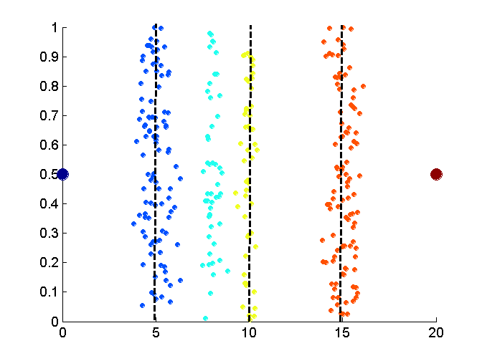
Unsupervised Discretization
Equal interval width approach used to obtain 4 values.

Slide 44
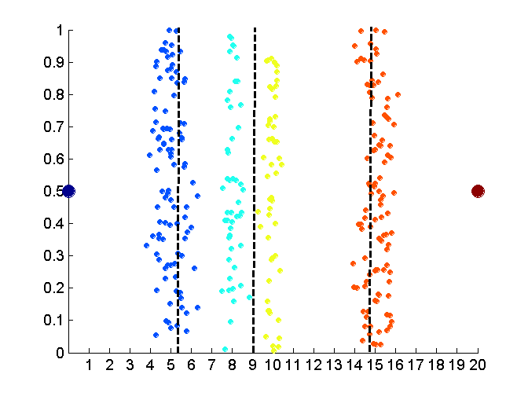
Unsupervised Discretization
Equal frequency approach used to obtain 4 values.

Slide 45
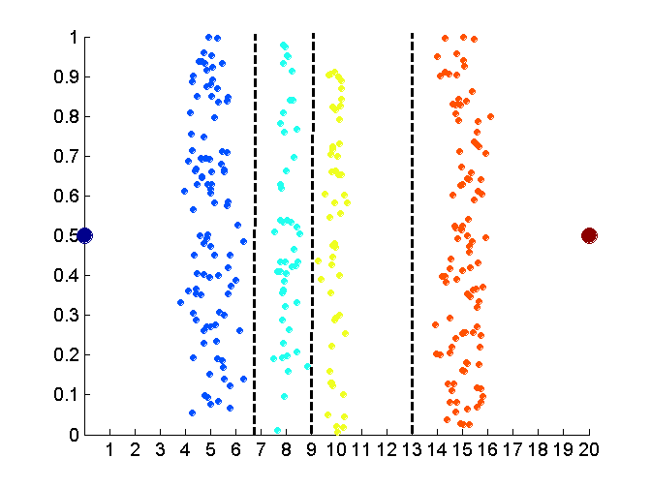
Unsupervised Discretization
K-means approach to obtain 4 values.

Slide 46
Discretization in Supervised Settings
Many classification algorithms work best if both the independent and dependent variables have only a few values
We give an illustration of the usefulness of discretization using the following example.

Slide 47
Binarization
Binarization maps a continuous or categorical attribute into one or more binary variables

Slide 48
Attribute Transformation
An attribute transform is a function that maps the entire set of values of a given attribute to a new set of replacement values such that each old value can be identified with one of the new values
Simple functions: x^{k}, log(x), e^{x}, |x|
Normalization
Refers to various techniques to adjust to differences among attributes in terms of frequency of occurrence, mean, variance, range
Take out unwanted, common signal, e.g., seasonality
In statistics, standardization refers to subtracting off the means and dividing by the standard deviation

Slide 49
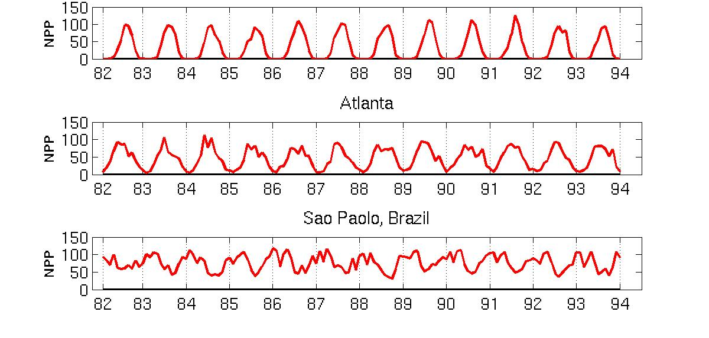
Example: Sample Time Series of Plant Growth
Minneapolis
Net Primary Production (NPP) is a measure of plant growth used by ecosystem scientists.
Correlations between time series
Correlations between time series

Slide 50
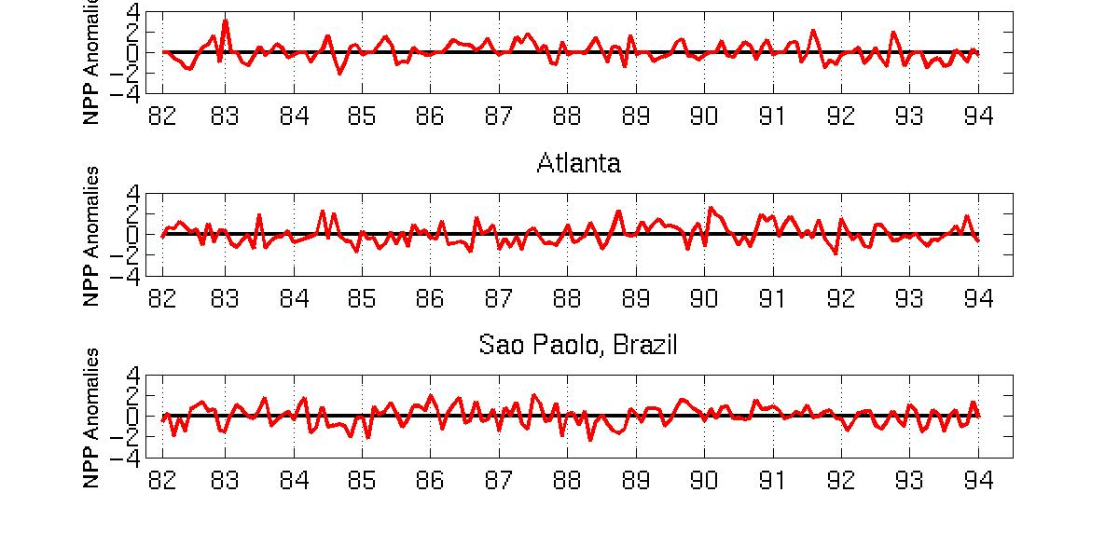
Seasonality Accounts for Much Correlation
Minneapolis
Normalized using monthly Z Score:
Subtract off monthly mean and divide by monthly standard deviation
Correlations between time series
Correlations between time series

Slide 51
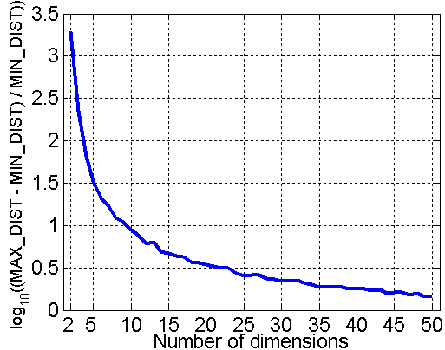
Curse of Dimensionality
When dimensionality increases, data becomes increasingly sparse in the space that it occupies
Definitions of density and distance between points, which are critical for clustering and outlier detection, become less meaningful
Randomly generate 500 points
Compute difference between max and min distance between any pair of points

Slide 52
Dimensionality Reduction
Purpose:
Avoid curse of dimensionality
Reduce amount of time and memory required by data mining algorithms
Allow data to be more easily visualized
May help to eliminate irrelevant features or reduce noise
Techniques
Principal Components Analysis (PCA)
Singular Value Decomposition
Others: supervised and non-linear techniques

Slide 53
Dimensionality Reduction: PCA
Goal is to find a projection that captures the largest amount of variation in data
x₂
e
x₁

Slide 54
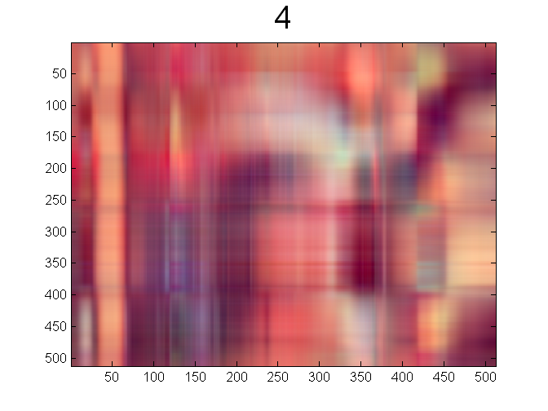
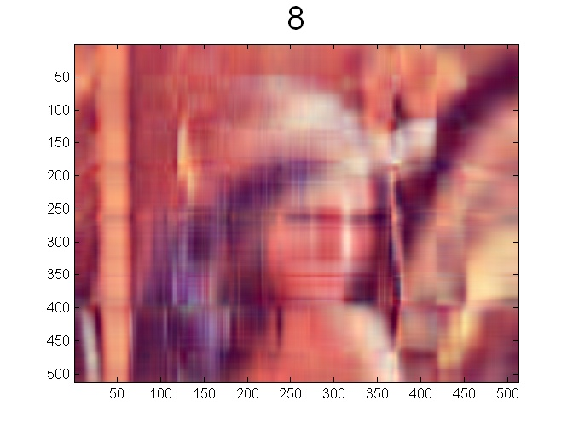


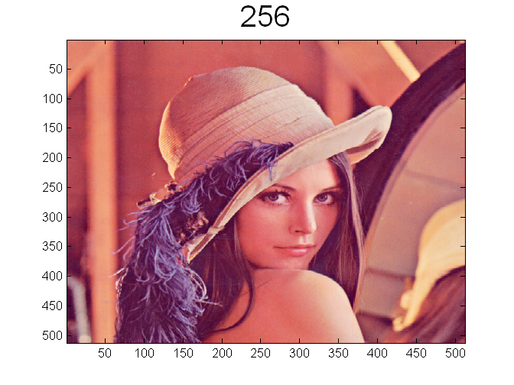
Dimensionality Reduction: PCA

Slide 55
Feature Subset Selection
Another way to reduce dimensionality of data
Redundant features
Duplicate much or all of the information contained in one or more other attributes
Example: purchase price of a product and the amount of sales tax paid
Irrelevant features
Contain no information that is useful for the data mining task at hand
Example: students' ID is often irrelevant to the task of predicting students' GPA
Many techniques developed, especially for classification

Slide 56
Feature Creation
Create new attributes that can capture the important information in a data set much more efficiently than the original attributes
Three general methodologies:
Feature extraction
Example: extracting edges from images
Feature construction
Example: dividing mass by volume to get density
Mapping data to new space
Example: Fourier and wavelet analysis

Slide 57
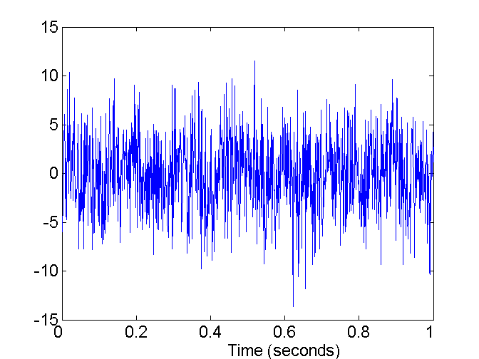
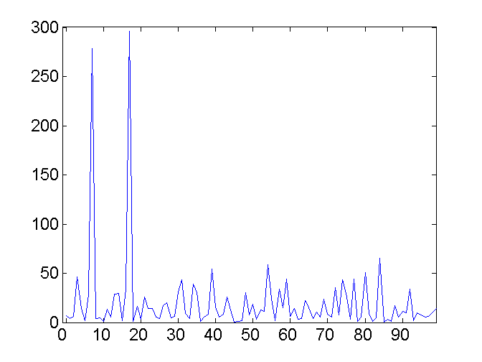
Mapping Data to a New Space
Fourier and wavelet transform
Frequency
Two Sine Waves + Noise
Frequency

